Slide 1



Development of a platform with 2 DoF to assist the cooperation between grounded mobile robots and UAVs in landing operations
Presented by José Lima
Authors: Emerson Kaneda; Guido Berger; Vitor Hugo Pinto; Milena Pinto;
Murilo Ferreira; Flávio Luiz Rossini; José Lima
1

Slide 2
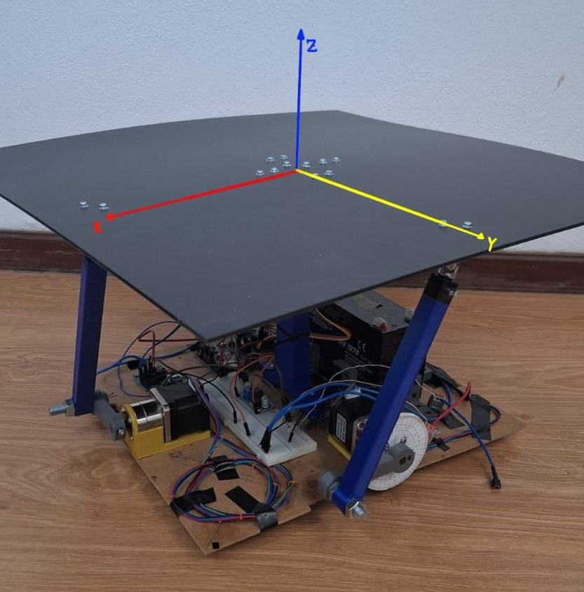
Prototype
Bidirectional platform
2 Degrees of Freedom
Hardware: ESP32
Motors: NEMA17 with gear box
Sensor: ADXL345 Accelerometer
2

Slide 3
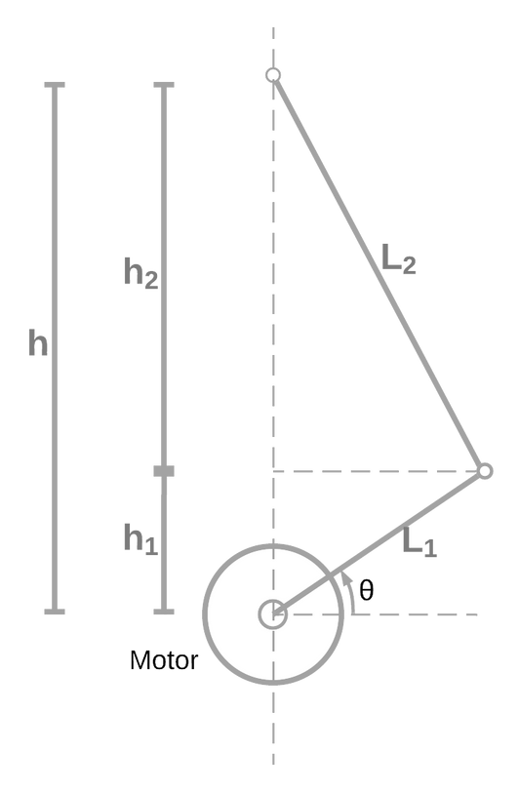
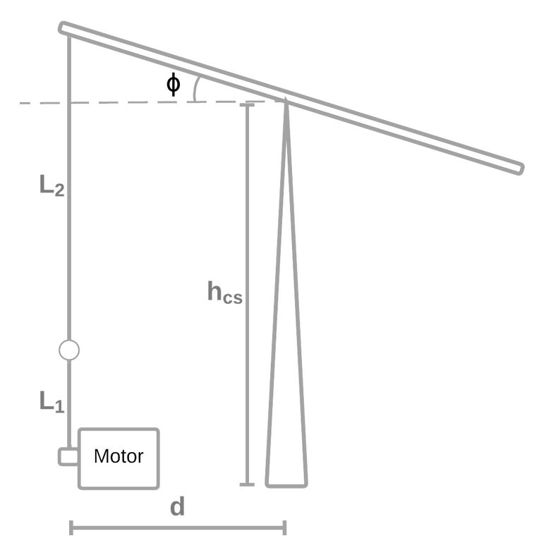


Kinematics analisys
3

Slide 4
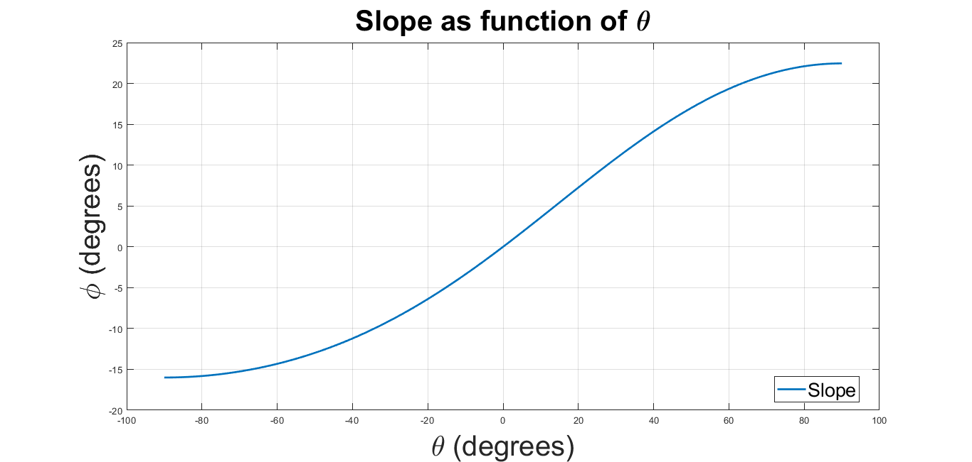
Kinematics Analisys
Minimum Angle: -16
Maximum Angle: 22.45
4

Slide 5
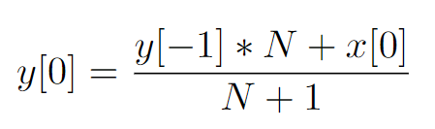
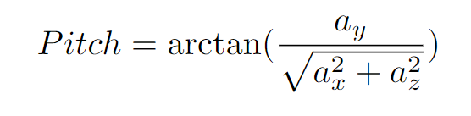
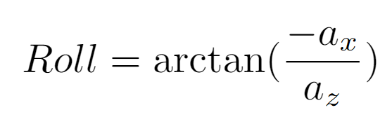
Data Filtering
Exponential moving average filter
Applying over the 3 accelerations measured to calculate Pitch and Roll
5

Slide 6
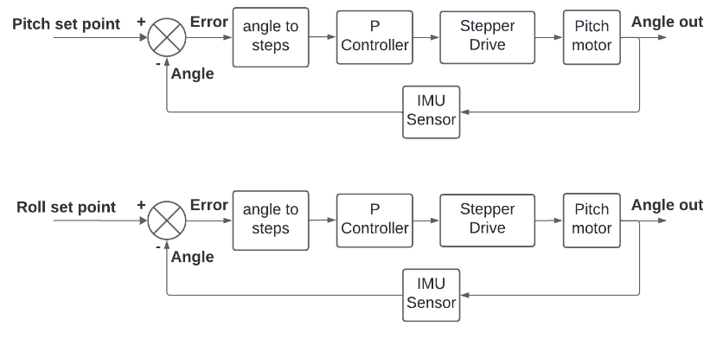
Control Diagram
6

Slide 7
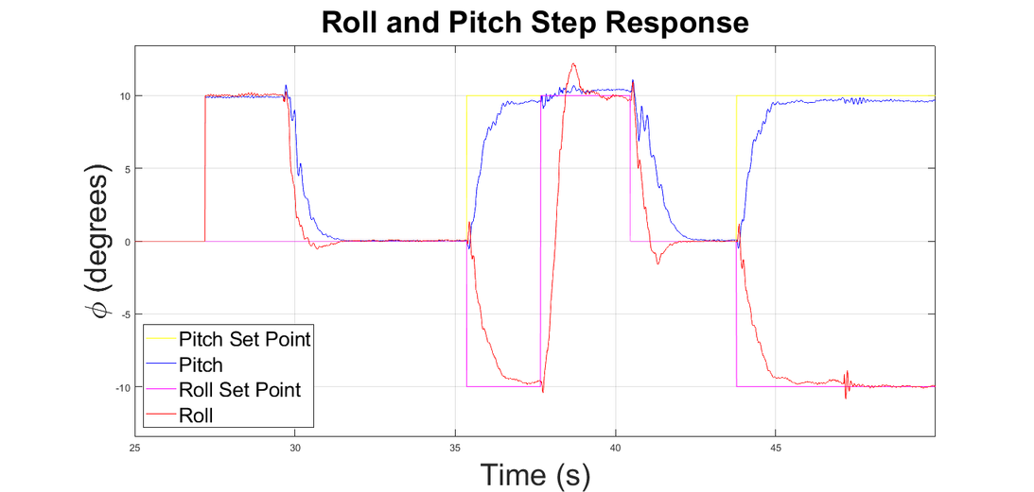
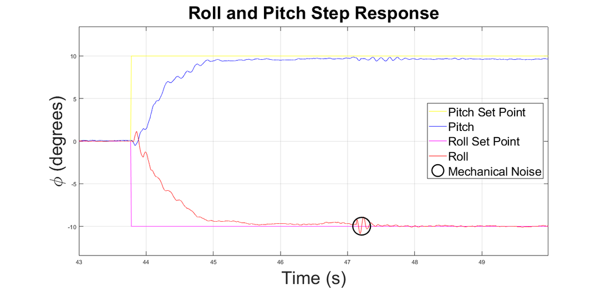
Step Response
Kp: 0.8
7

